Slide 1
Coursera Capstone Project The Battle of Neighbourhoods - Final Project Report Aashish Kumar Verma
Coursera Capstone - PRESENTATION

Slide 2
Introduction Section

Slide 3
Discussion of the business problem and the audience who would be interested in this project.
I am a data scientist currently residing in Bangalore India. I currently live within walking distance to "JP Nagar metro station" therefore I have access to good public transportation to work. Likewise, I enjoy many amenities in the neighbourhood , such as international cousin restaurants, cafes, food shops and entertainment. I have been offered a great opportunity to work in Manhattan, NY. Although, I am very excited about it, I am a bit stress toward the process to secure a comparable place to live in Manhattan. Therefore, I decided to apply the learned skills during the Coursera course to explore ways to make sure my decision is factual and rewarding. Of course, there are alternatives to achieve the answer using available Google and Social media tools, but it rewarding doing it myself with learned tools.

Slide 4
Problem to be resolved:
Apartment with min 2 bedrooms with monthly rent not to exceed US$7000/month
Unit located within walking distance (<=1.0 mile, 1.6 km) from a subway metro station in Manhattan
Area with amenities and venues similar to the ones described for current location ( See item 2.1)

Slide 5
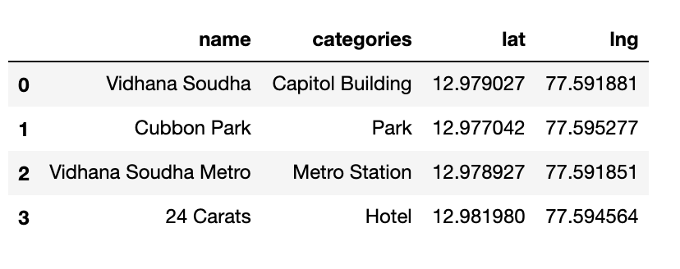
Mapping of Data
The following maps were created to facilitate the analysis and the choice of the palace to live. Manhattan map of Neighbourhoods Manhattan subway metro locations Manhattan map of places for rent Manhattan map of clustered venues and neighbourhoods Combined maps of Manhattan rent places with subway locations Combined maps of Manhattan rent places with subway locations and venues clusters

Slide 6
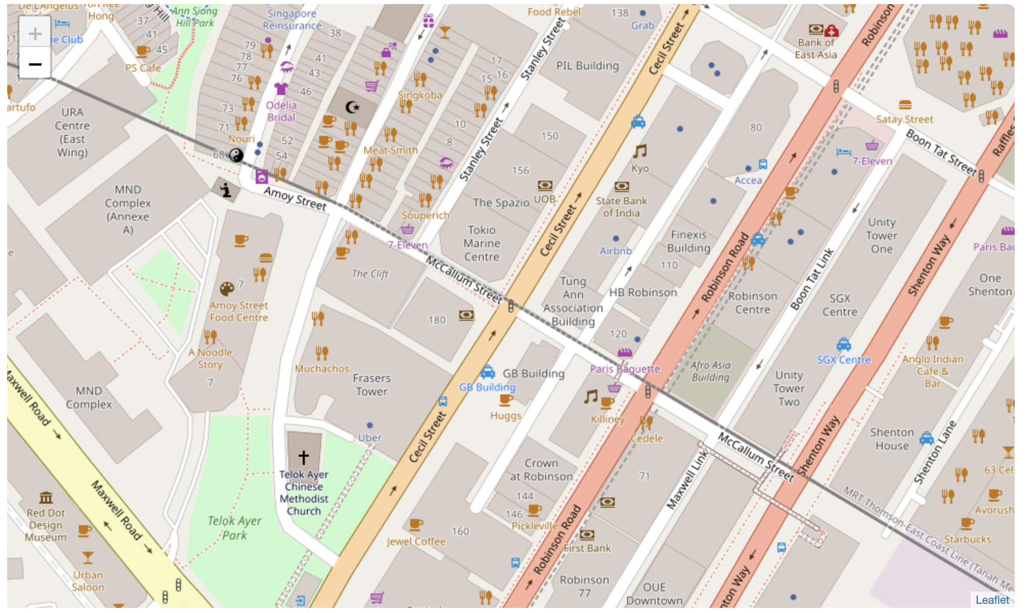
Map of Bangalore, India residence place with venues in Neighborhood - for reference

Slide 7
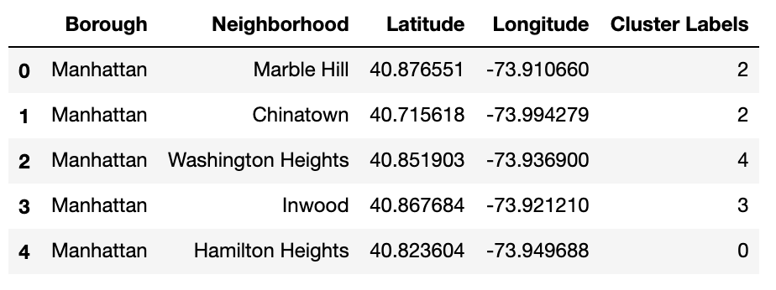
MANHATTAN NEIGHBORHOODS - DATA AND MAPPING

Slide 8
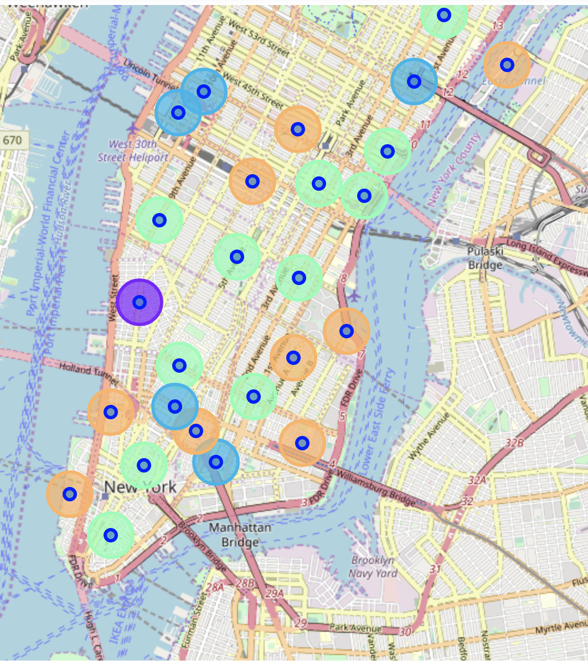
Map of Manhattan neighbourhoods with top 10 clustered venues Popups allow to identify each neighbourhood and the cluster of venues around it in order to proceed to examine in more detail in the next cell

Slide 9
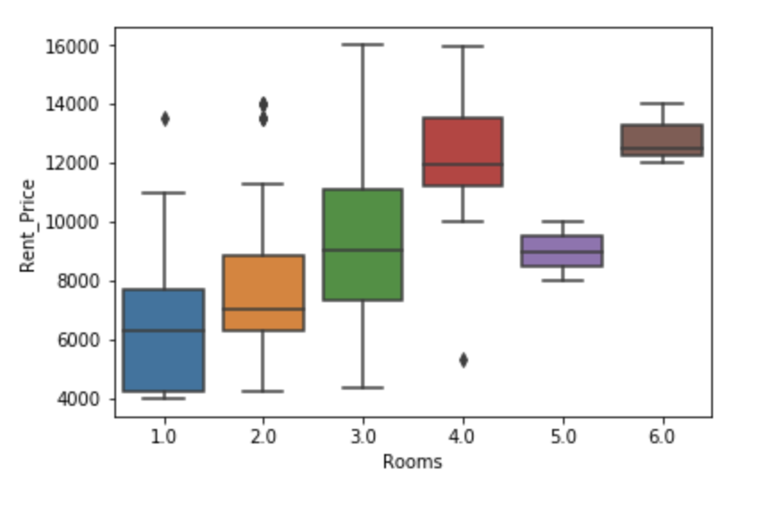
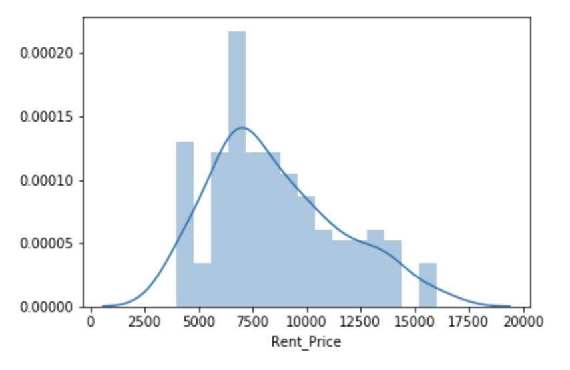
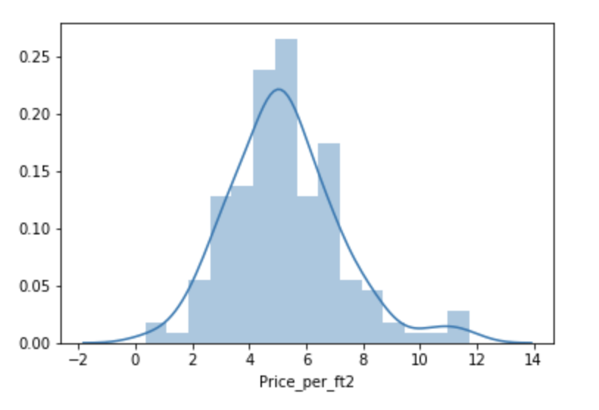
Manhattan apartment rent price statistics

Slide 10
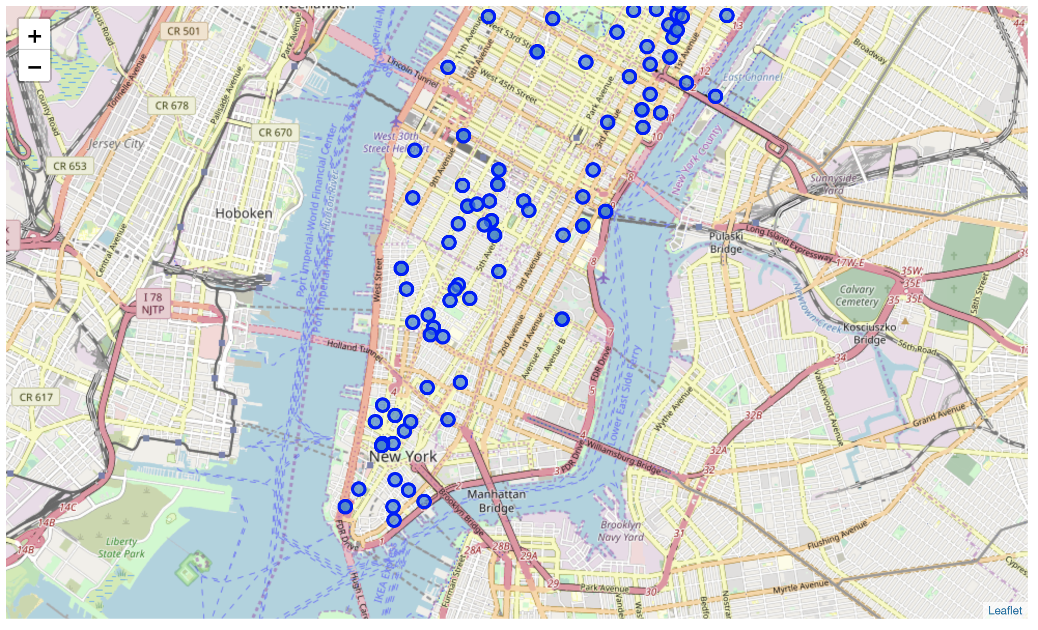
Map of Manhattan apartments for rent

Slide 11

Apartment Selection
Based on current Bangalore, India venues, I feel that Cluster 2 type of venues is a closer resemblance to my current place. That means that APARTMENT 1 is a better choice since the extra monthly rent is worth the conveniences it provides.

Slide 12

DISCUSSION
In general, I am positively impressed with the overall organization, content and lab works presented during the Coursera IBM Certification Course. There are appropriate guidelines have been provided by instructor with useful examples.
I feel this Capstone project presented me a great opportunity to practice and apply the Data Science tools and methodologies learned. In Capstone project, it enables my skill set to get hands on Python programming.
I have created a useful project that I can present as an example to show my potential.
I feel I have acquired a good starting point to become a professional Data Scientist and I will continue exploring to creating examples of practical cases.
Based on real data scenarios this project provides more confidence on analysis and algorithm on search and queries of real time solutions.

Slide 13
CONCLUSIONS
I feel rewarded with the efforts, time and money spent for students or professionals. I believe this course with all the topics covered is well worthy of appreciation and instructor guides us with great enthusiasm.
This project has shown me a practical application to resolve a real situation that has impacting personal and financial impact using Data Science tools. Even data visualization tools get more focus on queries.
The mapping with Folium is a very powerful technique to consolidate information and make the analysis and decision thoroughly and with confidence. I would recommend for use in similar situations.
One must keep abreast of new tools for Data Science that continue to appear for application in several business fields.
Thanks a lot!!

